Slide 1
Chapter 1
Introduction on Mathematical Modeling, Numerical Methods, and Problem Solving

Slide 2
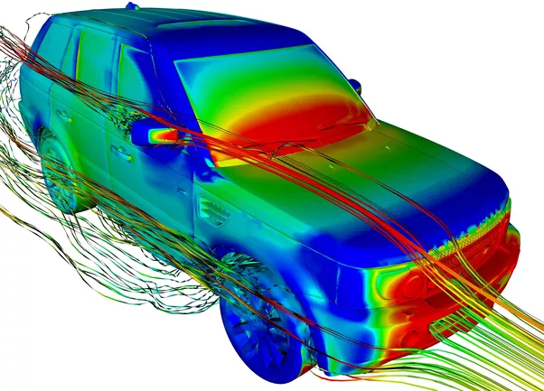

Computational Methods for Engineers
Real
system
Model
system
Perform
experiments
Perform
Simulations
Simulation
(= “virtual” experiment)
Obtain
experimental
results
Obtain
simulation
results

Slide 3
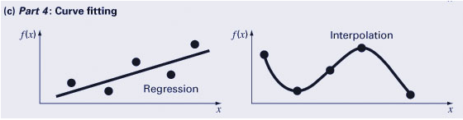
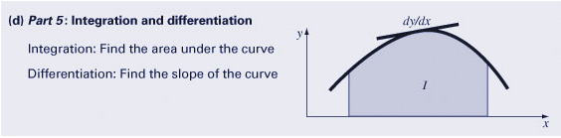
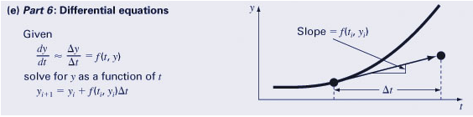
Summary of Numerical Methods
The book is divided into five categories of numerical methods:

Slide 4
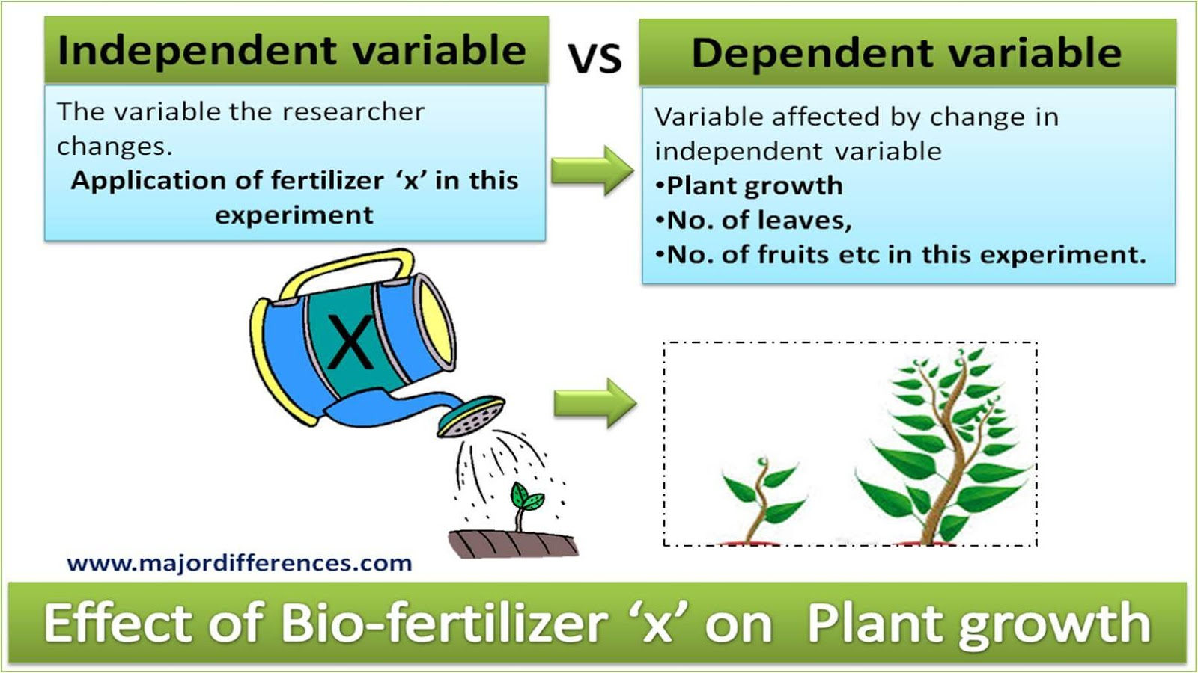
Independent vs. Dependent Variables

Slide 5
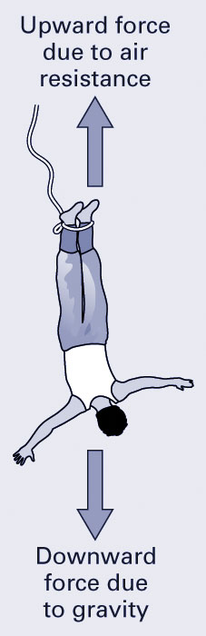
Model Function Example
Assuming a bungee jumper is in mid-flight, from Newton's second law that the change in velocity is determined by the gravitational forces acting on the jumper versus the drag force.
To determine the velocity of the jumper over time, we need to solve the differential equation above.
Analytical (Exact, closed form) Solution
Numerical (Estimated) Solution
Notes:
The differential equations ca

Slide 6
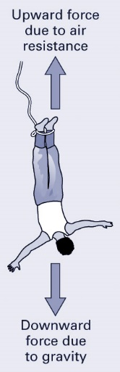
Model Function Example: Analytical Solution
An analytical model for the jumper’s velocity, accounting for drag, is
Dependent variable - velocity v
Independent variables - time t
Parameters - mass m, drag coefficient c_{d}

Slide 7
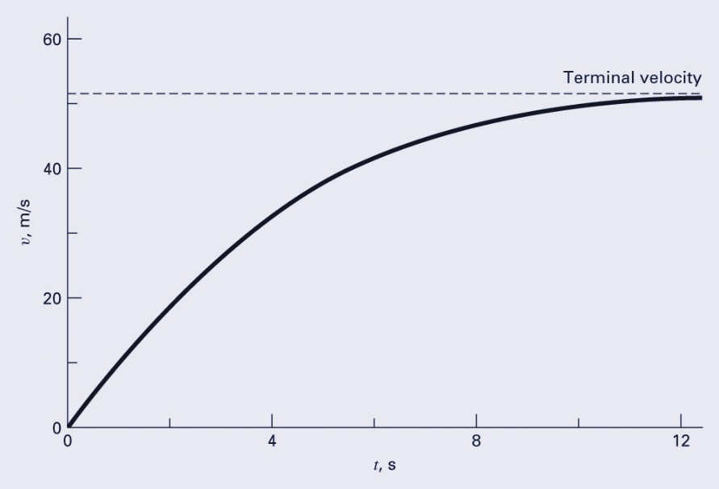
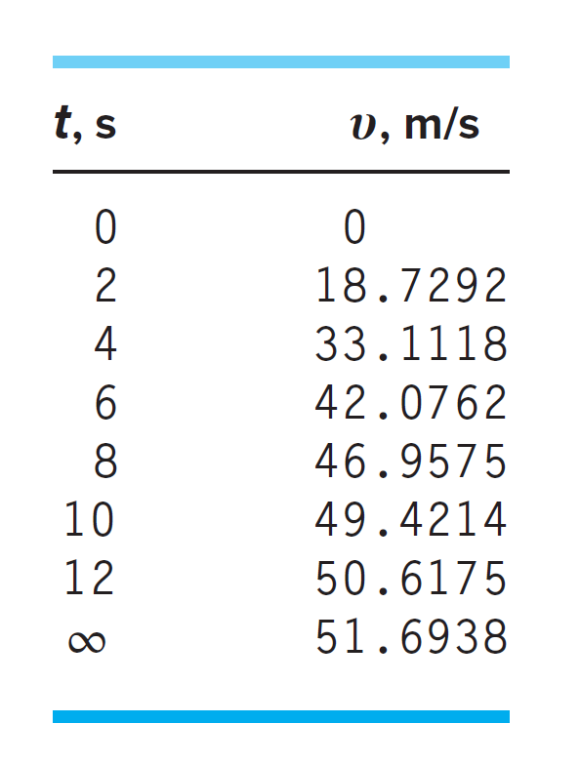
Model Results
Using a computer (or a calculator), the model can be used to generate a graphical representation of the system. For example, the graph below represents the velocity of a 68.1 kg jumper, assuming a drag coefficient of 0.25 kg/m

Slide 8
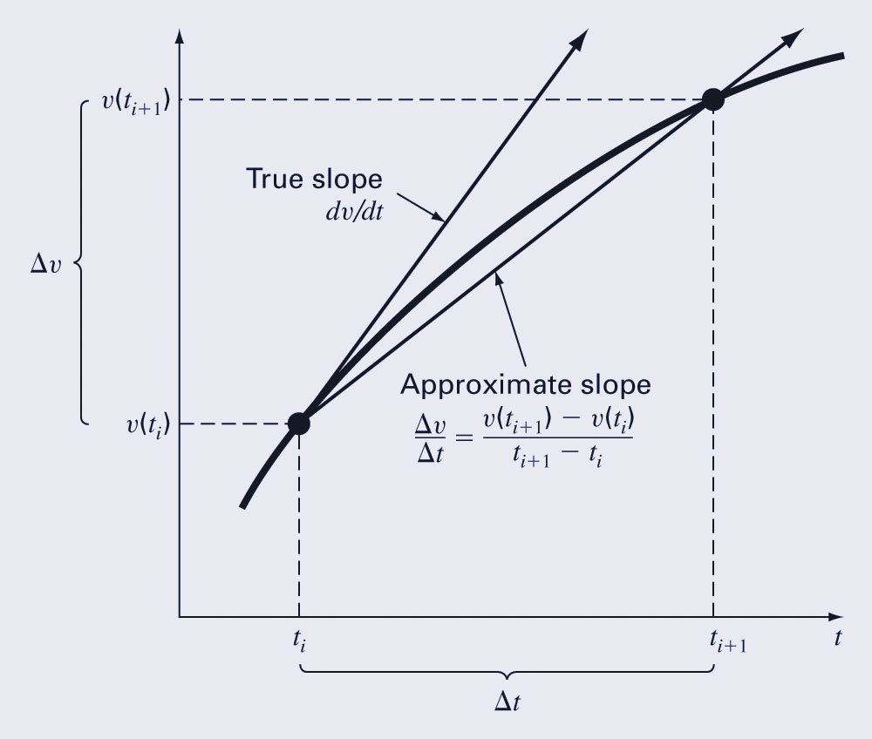
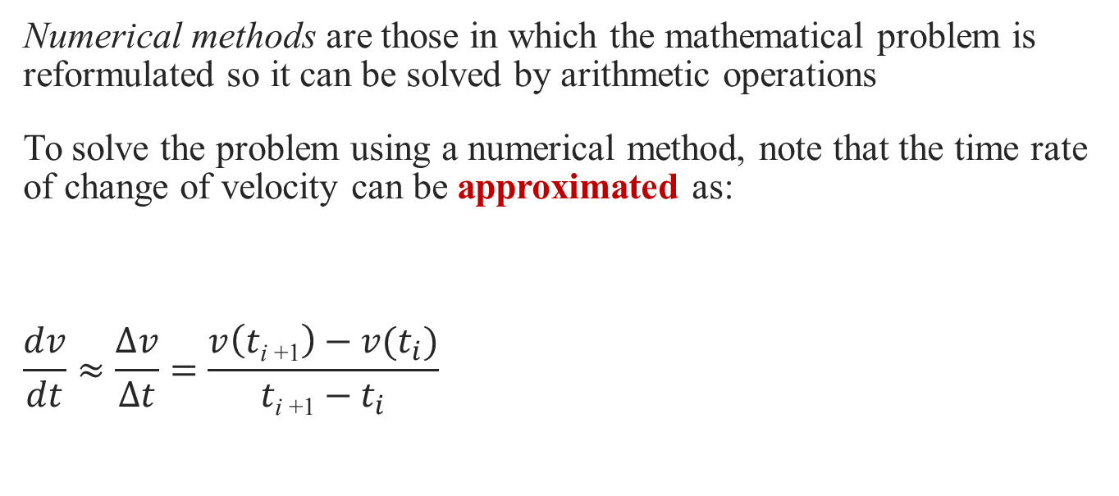
Numerical Methods
Numerical methods are those in which the mathematical problem is reformulated so it can be solved by arithmetic operations
To solve the problem using a numerical method, note that the time rate of change of velocity can be approximated as:
$$\frac{dv}{dt}≈\frac{∆v}{∆t}=\frac{v\left(t\text{i}\text{ +1}\right)−v(t_{i})}{t\text{i}\text{ +1}−t_{i}}$$

Slide 9
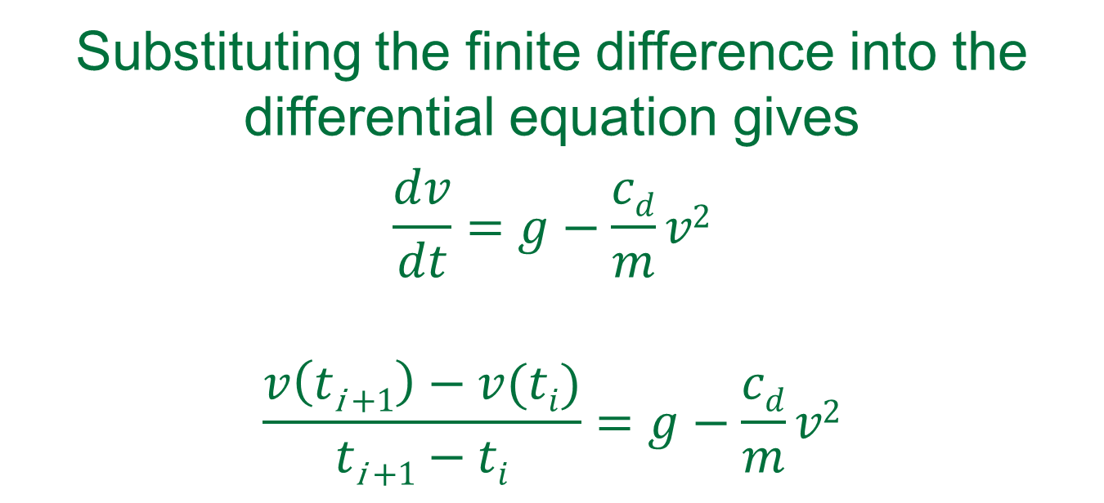
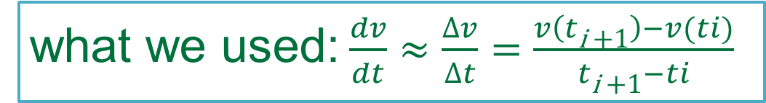
Euler’s Method
Substituting the finite difference into the differential equation gives
$$\frac{dv}{dt}=g−\frac{cd}{m}v2$$
$$\frac{v\left(t\text{i}\text{ +1}\right)−v(ti)}{t\text{i}\text{ +1}−ti}=g−\frac{cd}{m}v2$$
what we used:$\frac{dv}{dt}≈\frac{∆v}{∆t}=\frac{v\left(t\text{i}\text{ +1}\right)−v(ti)}{t\text{i}\text{ +1}−ti}$

Slide 10

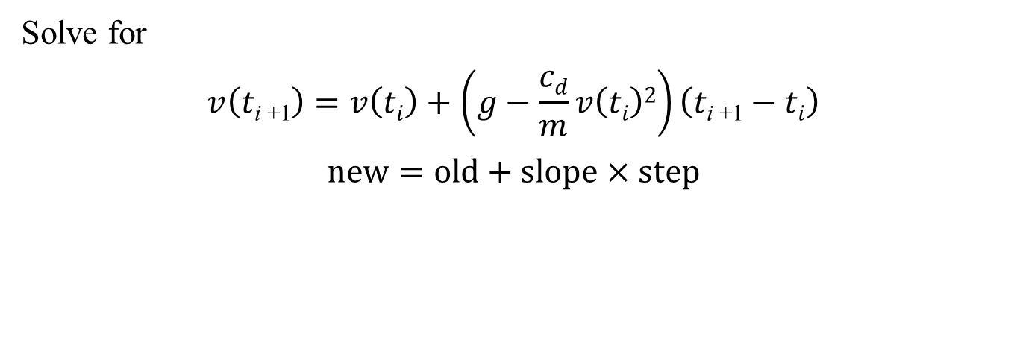
Euler’s Method
Substituting the finite difference into the differential equation gives
$$\frac{dv}{dt}=g−\frac{cd}{m}v2$$
$$\frac{v\left(t\text{i}\text{ +1}\right)−v(ti)}{t\text{i}\text{ +1}−ti}=g−\frac{cd}{m}v2$$
Solve for
$$v\left(t\text{i}\text{ +1}\right)=v\left(ti\right)+\left(g−\frac{cd}{m}v\left(ti\right)2\right)\left(t\text{i}\text{ +1}−ti\right)$$
$$new=old+slope×step$$
Notes:
We can now see that the differential equation has been transformed into an equation that
can be used to determine the velocity algebraically at ti+1 using the slope and previous values
of υ and t.

Slide 11
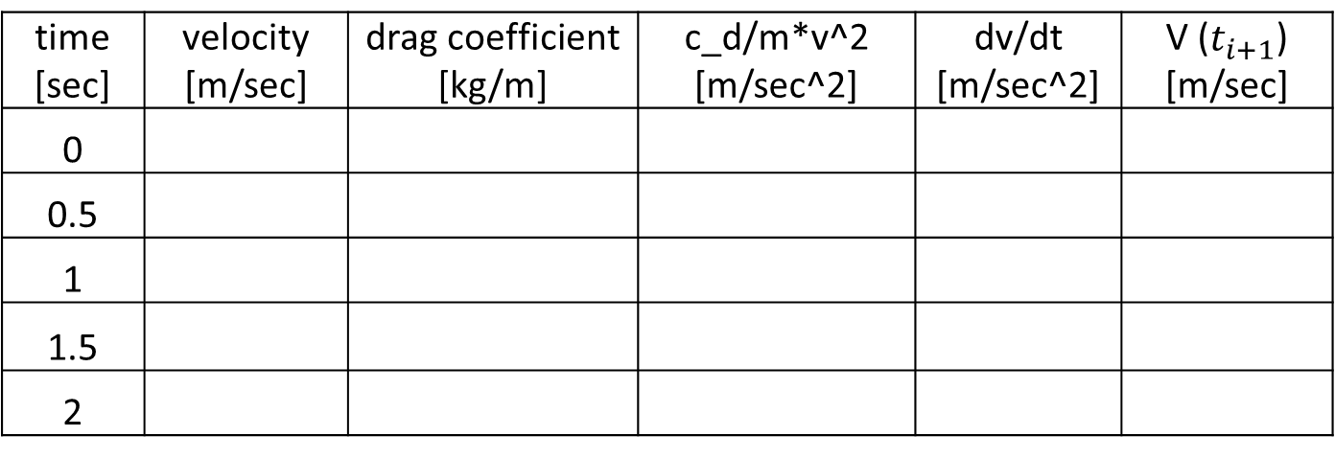
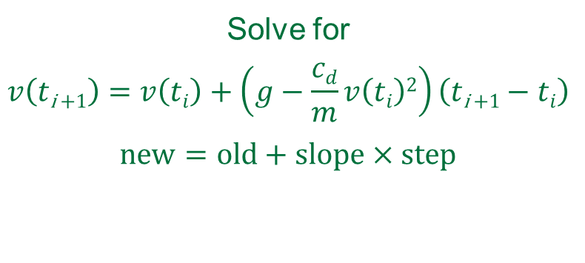
Classroom Example
Simulation Settings
m [kg] | 80
g [m/sec^2] | 9.81
DELTA_t [sec] | 0.5
initial velocity [m/sec] | 0
Solve for
$$v\left(t\text{i}\text{ +1}\right)=v\left(ti\right)+\left(g−\frac{cd}{m}v\left(ti\right)2\right)\left(t\text{i}\text{ +1}−ti\right)$$
$$new=old+slope×step$$
time [sec] | velocity [m/sec] | drag coefficient [kg/m] | c_d/m*v^2 [m/sec^2] | dv/dt [m/sec^2] | V ($t_{i+1}$) [m/sec]
0
0.5
1
1.5
2

Slide 12
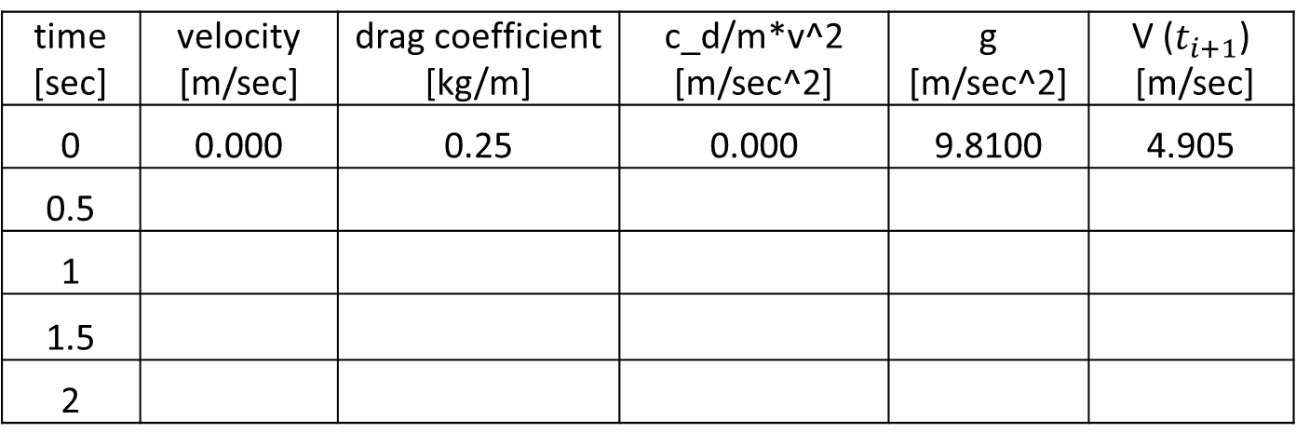
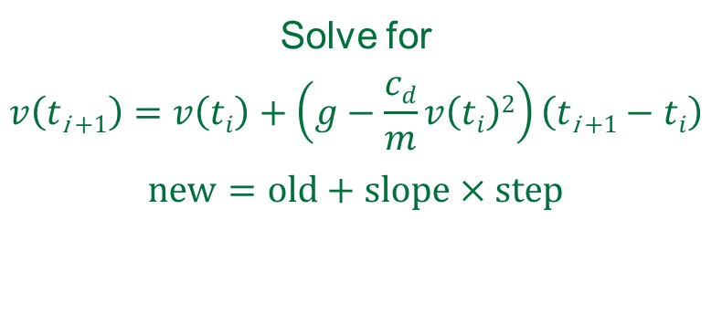
Classroom Example
Solve for
$$v\left(t\text{i}\text{ +1}\right)=v\left(ti\right)+\left(g−\frac{cd}{m}v\left(ti\right)2\right)\left(t\text{i}\text{ +1}−ti\right)$$
$$new=old+slope×step$$
Simulation Settings
m [kg] | 80
g [m/sec^2] | 9.81
DELTA_t [sec] | 0.5
initial velocity [m/sec] | 0
time [sec] | velocity [m/sec] | drag coefficient [kg/m] | c_d/m*v^2 [m/sec^2] | g [m/sec^2] | V ($t_{i+1}$) [m/sec]
0 | 0.000 | 0.25 | 0.000 | 9.8100 | 4.905
0.5
1
1.5
2

Slide 13
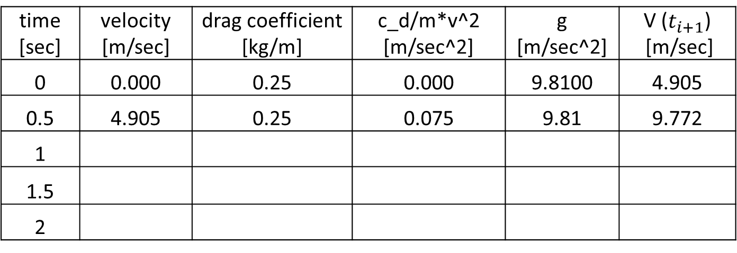
Classroom Example
Solve for
$$v\left(t\text{i}\text{ +1}\right)=v\left(ti\right)+\left(g−\frac{cd}{m}v\left(ti\right)2\right)\left(t\text{i}\text{ +1}−ti\right)$$
$$new=old+slope×step$$
Simulation Settings
m [kg] | 80
g [m/sec^2] | 9.81
DELTA_t [sec] | 0.5
initial velocity [m/sec] | 0
time [sec] | velocity [m/sec] | drag coefficient [kg/m] | c_d/m*v^2 [m/sec^2] | g [m/sec^2] | V ($t_{i+1}$) [m/sec]
0 | 0.000 | 0.25 | 0.000 | 9.8100 | 4.905
0.5 | 4.905 | 0.25 | 0.075 | 9.81 | 9.772
1
1.5
2

Slide 14
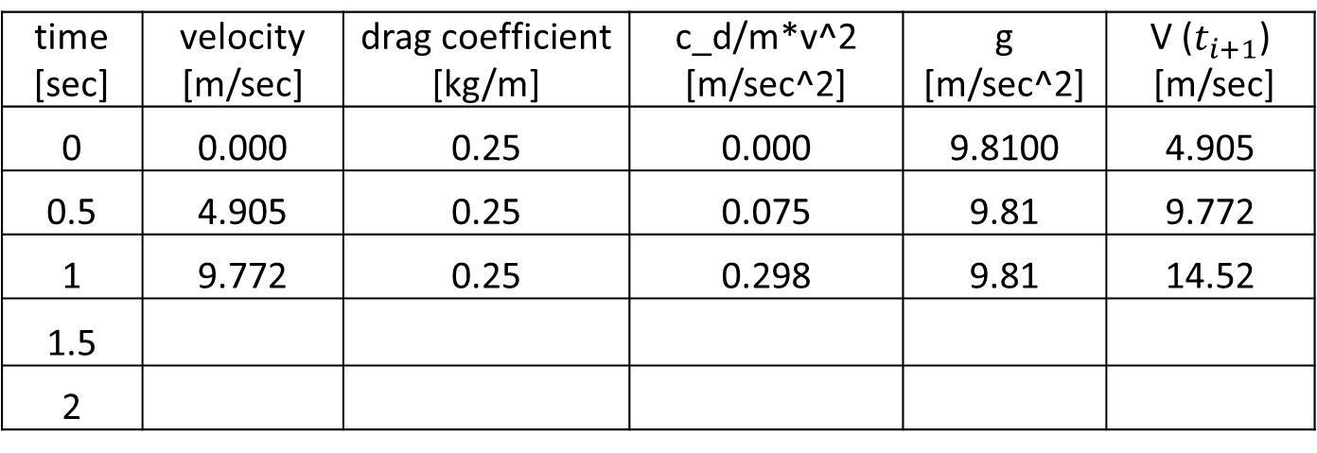
Classroom Example
Solve for
$$v\left(t\text{i}\text{ +1}\right)=v\left(ti\right)+\left(g−\frac{cd}{m}v\left(ti\right)2\right)\left(t\text{i}\text{ +1}−ti\right)$$
$$new=old+slope×step$$
Simulation Settings
m [kg] | 80
g [m/sec^2] | 9.81
DELTA_t [sec] | 0.5
initial velocity [m/sec] | 0
time [sec] | velocity [m/sec] | drag coefficient [kg/m] | c_d/m*v^2 [m/sec^2] | g [m/sec^2] | V ($t_{i+1}$) [m/sec]
0 | 0.000 | 0.25 | 0.000 | 9.8100 | 4.905
0.5 | 4.905 | 0.25 | 0.075 | 9.81 | 9.772
1 | 9.772 | 0.25 | 0.298 | 9.81 | 14.52
1.5
2

Slide 15
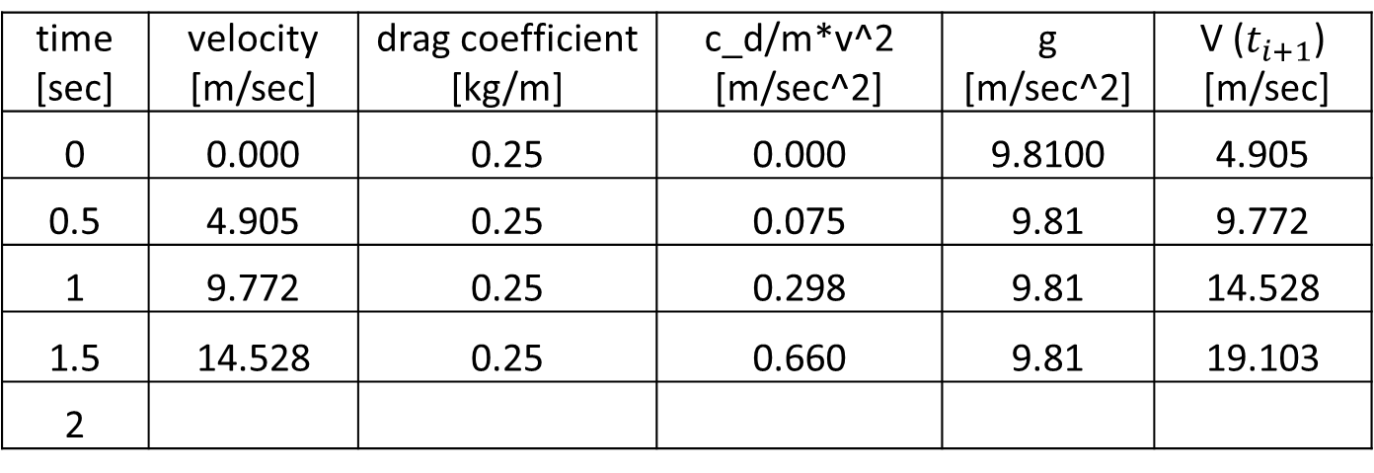
Classroom Example
Solve for
$$v\left(t\text{i}\text{ +1}\right)=v\left(ti\right)+\left(g−\frac{cd}{m}v\left(ti\right)2\right)\left(t\text{i}\text{ +1}−ti\right)$$
$$new=old+slope×step$$
Simulation Settings
m [kg] | 80
g [m/sec^2] | 9.81
DELTA_t [sec] | 0.5
initial velocity [m/sec] | 0
time [sec] | velocity [m/sec] | drag coefficient [kg/m] | c_d/m*v^2 [m/sec^2] | g [m/sec^2] | V ($t_{i+1}$) [m/sec]
0 | 0.000 | 0.25 | 0.000 | 9.8100 | 4.905
0.5 | 4.905 | 0.25 | 0.075 | 9.81 | 9.772
1 | 9.772 | 0.25 | 0.298 | 9.81 | 14.528
1.5 | 14.528 | 0.25 | 0.660 | 9.81 | 19.103
2

Slide 16
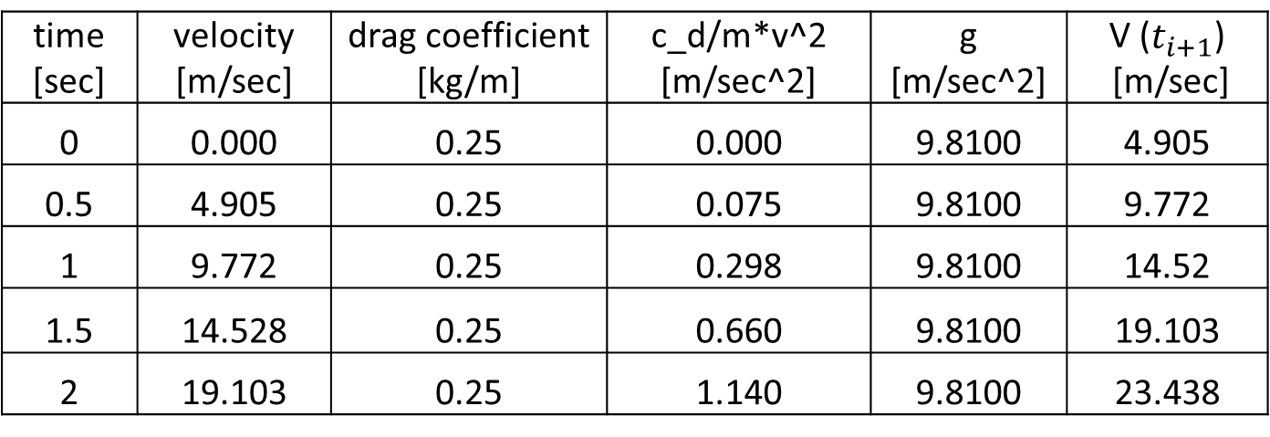
Classroom Example
Solve for
$$v\left(t\text{i}\text{ +1}\right)=v\left(ti\right)+\left(g−\frac{cd}{m}v\left(ti\right)2\right)\left(t\text{i}\text{ +1}−ti\right)$$
$$new=old+slope×step$$
Simulation Settings
m [kg] | 80
g [m/sec^2] | 9.81
DELTA_t [sec] | 0.5
initial velocity [m/sec] | 0
time [sec] | velocity [m/sec] | drag coefficient [kg/m] | c_d/m*v^2 [m/sec^2] | g [m/sec^2] | V ($t_{i+1}$) [m/sec]
0 | 0.000 | 0.25 | 0.000 | 9.8100 | 4.905
0.5 | 4.905 | 0.25 | 0.075 | 9.8100 | 9.772
1 | 9.772 | 0.25 | 0.298 | 9.8100 | 14.52
1.5 | 14.528 | 0.25 | 0.660 | 9.8100 | 19.103
2 | 19.103 | 0.25 | 1.140 | 9.8100 | 23.438

Slide 17
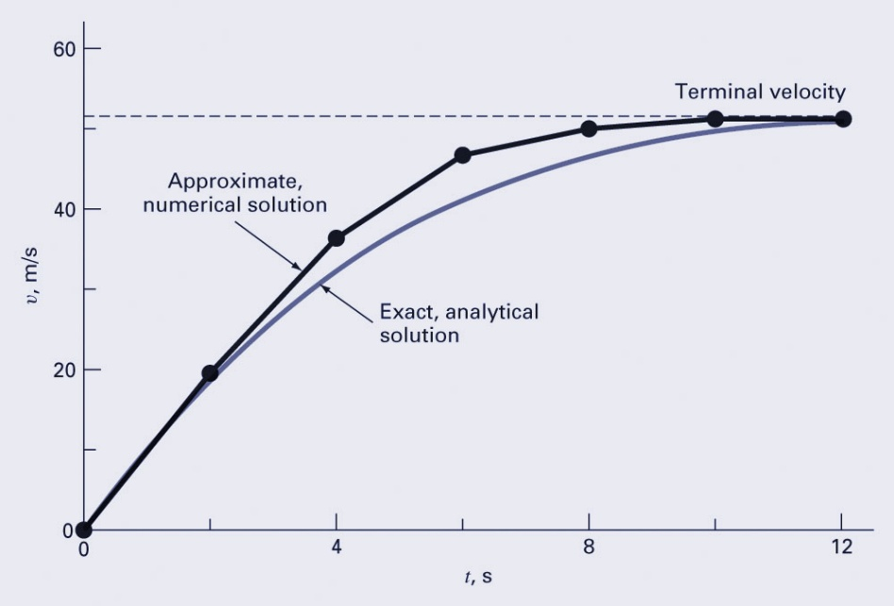
Numerical Results
As shown in later chapters, the efficiency and accuracy of numerical methods will depend upon how the method is applied.
Applying the previous method in 2 s intervals yields:

Slide 18
Bases for Numerical Models
Conservation laws provide the foundation for many model functions.
The three conservation laws that we have are:
Conservation of mass
Conservation of momentum
Conservation of energy

Slide 20
Example
(problem 1.27)
Suppose that a parachutist with linear drag (m = 70 kg, c = 12.5 kg/s) jumps from an airplane flying at an altitude of 200 m with a horizontal velocity of 180 m/s relative to the ground.
(a) Write a system of four differential equations for x, y, υ_{x} = dx/dt and υ_{y} = dy/dt.
(b) If the initial horizontal position is defined as x = 0, use Euler’s methods with Δt = 1 s to compute the jumper’s position over the first 10 seconds.

Slide 21
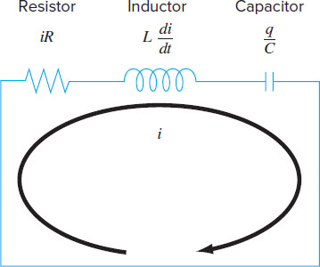
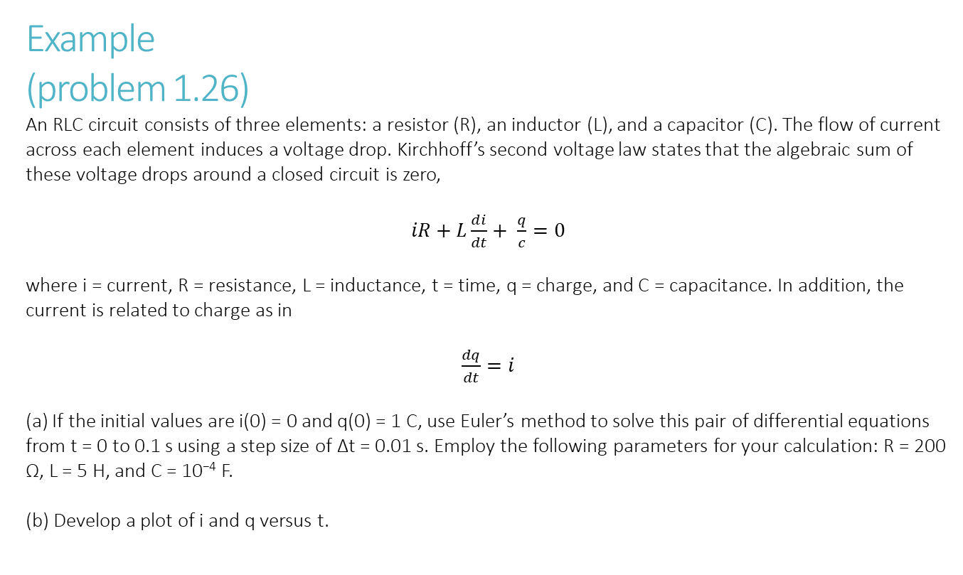
Example
(problem 1.26)
An RLC circuit consists of three elements: a resistor (R), an inductor (L), and a capacitor (C). The flow of current across each element induces a voltage drop. Kirchhoff’s second voltage law states that the algebraic sum of these voltage drops around a closed circuit is zero,
$iR+L\frac{di}{dt}+ \frac{q}{c}=0$
where i = current, R = resistance, L = inductance, t = time, q = charge, and C = capacitance. In addition, the current is related to charge as in
$\frac{dq}{dt}=i$
(a) If the initial values are i(0) = 0 and q(0) = 1 C, use Euler’s method to solve this pair of differential equations from t = 0 to 0.1 s using a step size of Δt = 0.01 s. Employ the following parameters for your calculation: R = 200 Ω, L = 5 H, and C = 10⁻⁴ F.
(b) Develop a plot of i and q versus t.

Slide 22
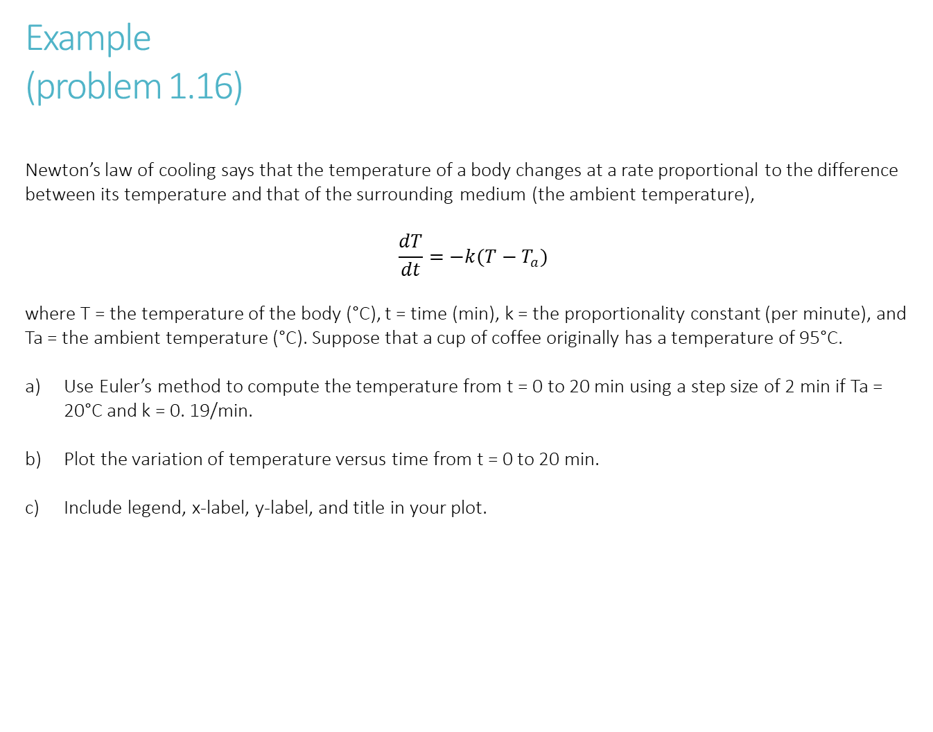
Example
(problem 1.16)
Newton’s law of cooling says that the temperature of a body changes at a rate proportional to the difference between its temperature and that of the surrounding medium (the ambient temperature),
$$\frac{dT}{dt}=−k(T−T_{a})$$
where T = the temperature of the body (°C), t = time (min), k = the proportionality constant (per minute), and Ta = the ambient temperature (°C). Suppose that a cup of coffee originally has a temperature of 95°C.
Use Euler’s method to compute the temperature from t = 0 to 20 min using a step size of 2 min if Ta = 20°C and k = 0. 19/min.
Plot the variation of temperature versus time from t = 0 to 20 min.
Include legend, x-label, y-label, and title in your plot.

